Slide 1

DNS Based Ad Blocking Project Domain: Cyber Security Project Group: Bhushan Parkhi (53) Om Chandgude (20) Chhabildas Yewale (08) Akshay Jedhe (55)
ISB&M College of Engineering

Slide 2
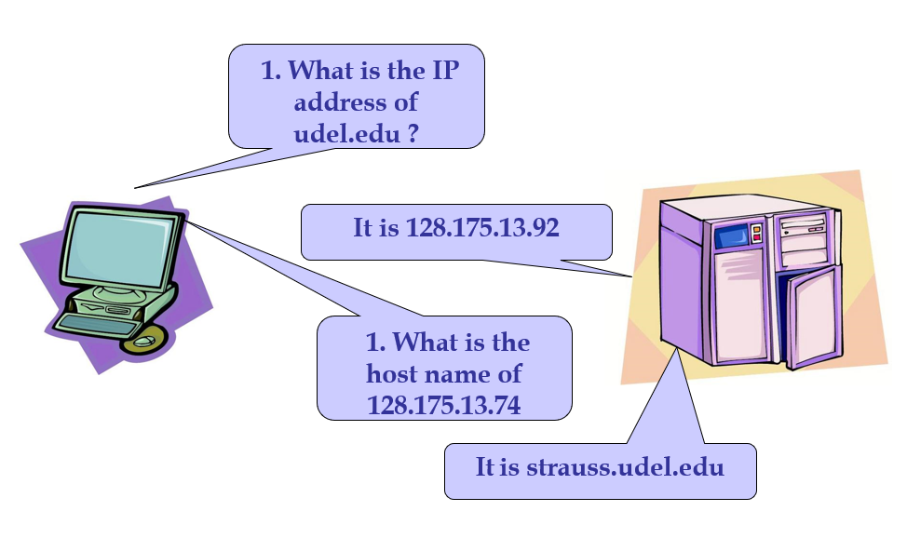
What is DNS?
DNS stands for Domain Name System
It is used to map names (www.google.com) to IP addresses (192.190.196.18)
Mapping host names into their corresponding IP addresses is called name resolution or name translation or Address Resolution

Slide 3
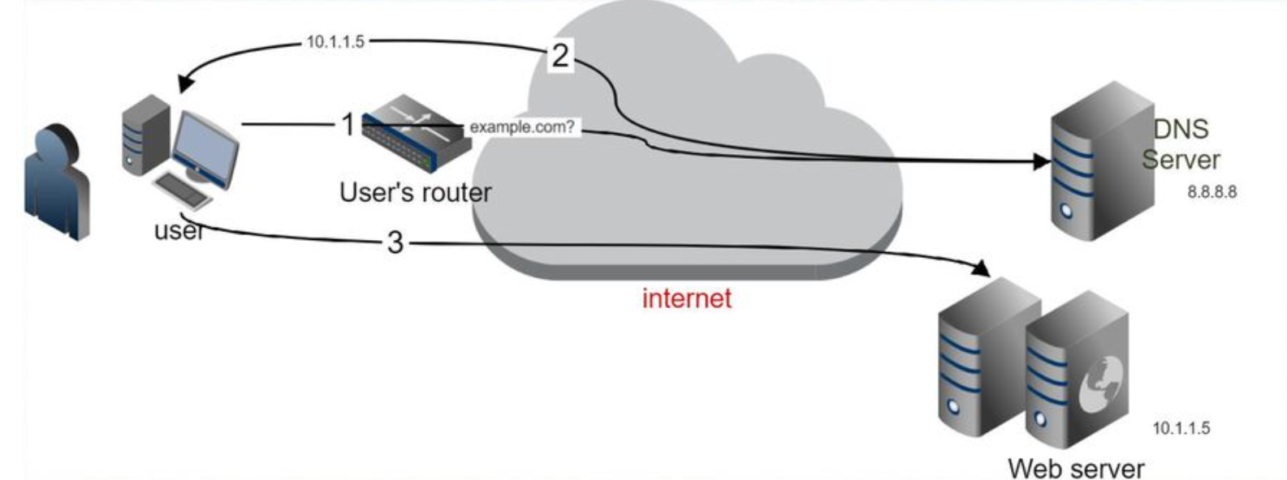
How does DNS work?
Clients use a mechanism called a resolver and ask servers – this is called a query.
The server being queried will try to find the answer on behalf of the client.
The server functions recursively, from top (root) to bottom, until it finds the answer, asking other servers along the way – the server is referred to other servers.

Slide 4
Why use Custom DNS for ad blocking?
Content is blocked in non-traditional locations, such as mobile games, streaming platforms, and other IOT devices on your network
Caching DNS queries does not affect loading times
Can function as a DHCP server, ensuring all your devices are protected automatically
Blocks ads over both IPv4 and IPv6
Better and more robust than a browser extension

Slide 5
Why block Internet? Can’t you just leave the internet alone?!
Flash ads which hijack pages
Pop-up and pop-under ads
Ads which stalk us on all of our devices
Ad networks which track and profile
Ads that tell me I’ve won stuff
Ads that phish users
And, Malvertising…
No!
Because…

Slide 6
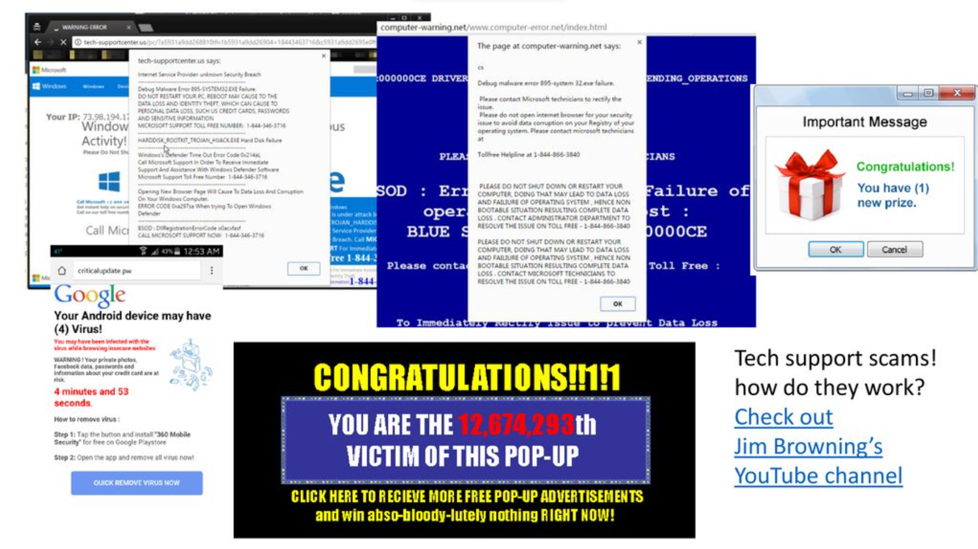





Slide 7
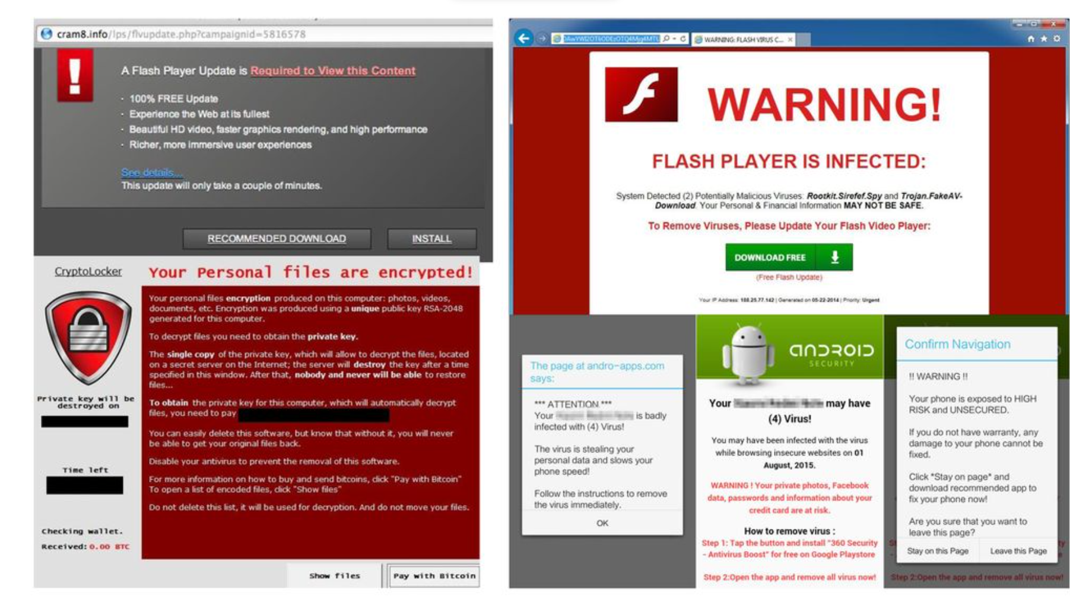

Slide 8
How DNS works with custom ad blocking
You open your favorite web browser
You type amazon.in in the address bar
Our Custom DNS server looks up amazon.in and begins downloading it
It will detect the domains used to serve advertisements (from crowd sourced databases) and instead of looking up the real address of those sites, it will send a fake address instead
This allows the legitimate content on amazon.in to load, but prevents the ad images and videos from being downloaded

Slide 9
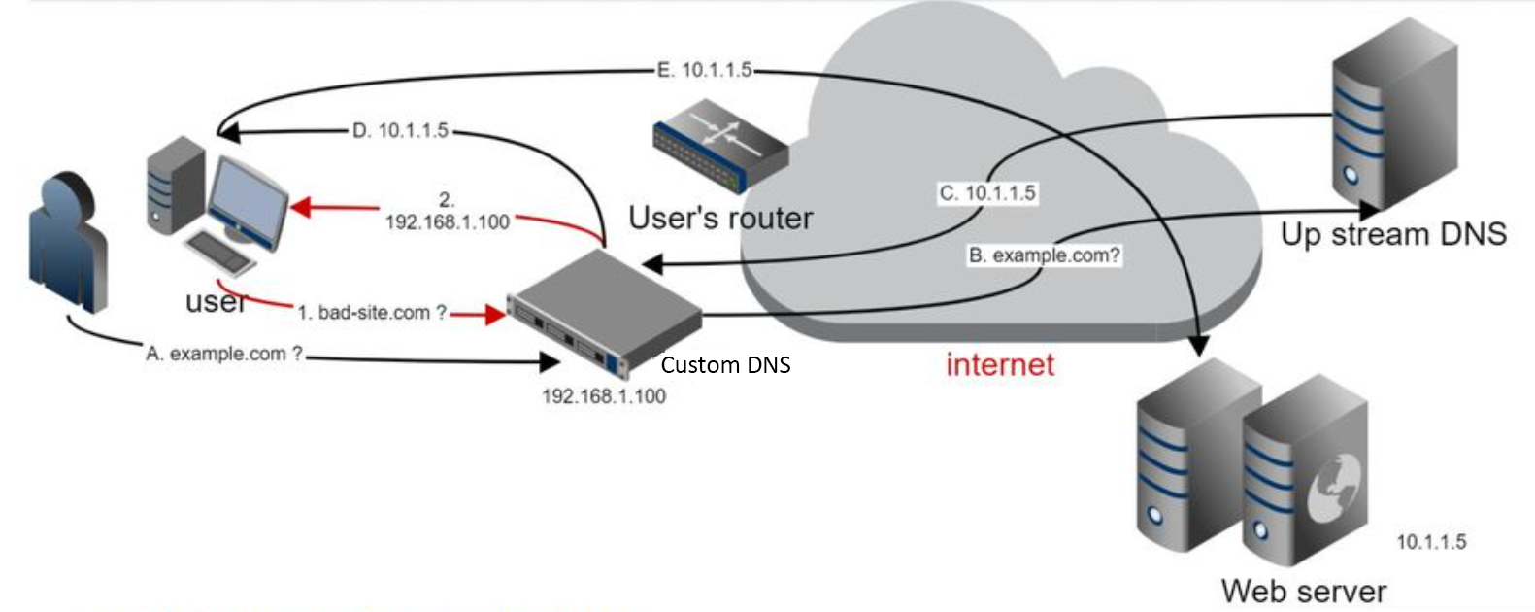
How DNS works with custom ad blocking

Slide 10
But ad blockers extensions exist. Why we need DNS based ad blocking?
Extensions are limited to use in browsers only
With DNS filtering it can prevent malicious ads and sites system-wide
Custom DNS can be implemented at Router level which will filter entire network
Provides privacy, security to users
Can be used to bypass censorship

Slide 11
Resources Used
Software
Ubuntu Server
dnscrypt
Pi Hole
Hardware
Router

Slide 12
References
1. Introduction to the Domain Name System (DNS)
Publisher: Wiley-IEEE Press, ISBN:9781119328292
2. DNS Security Challenges and Best Practices to Deploy Secure DNS with Digital Signatures
M. H. Jalalzai, W. B. Shahid and M. M. W. Iqbal,
National University of Sciences and Technology
3. Design and Implementation of Traditional DNS Protocol
Qi Li, Xingqun Qi,Jiaming Liu, Hongfeng Han
International school, Beijing University of Posts and Telecommunications Beijing 100876, China

